Slide 1

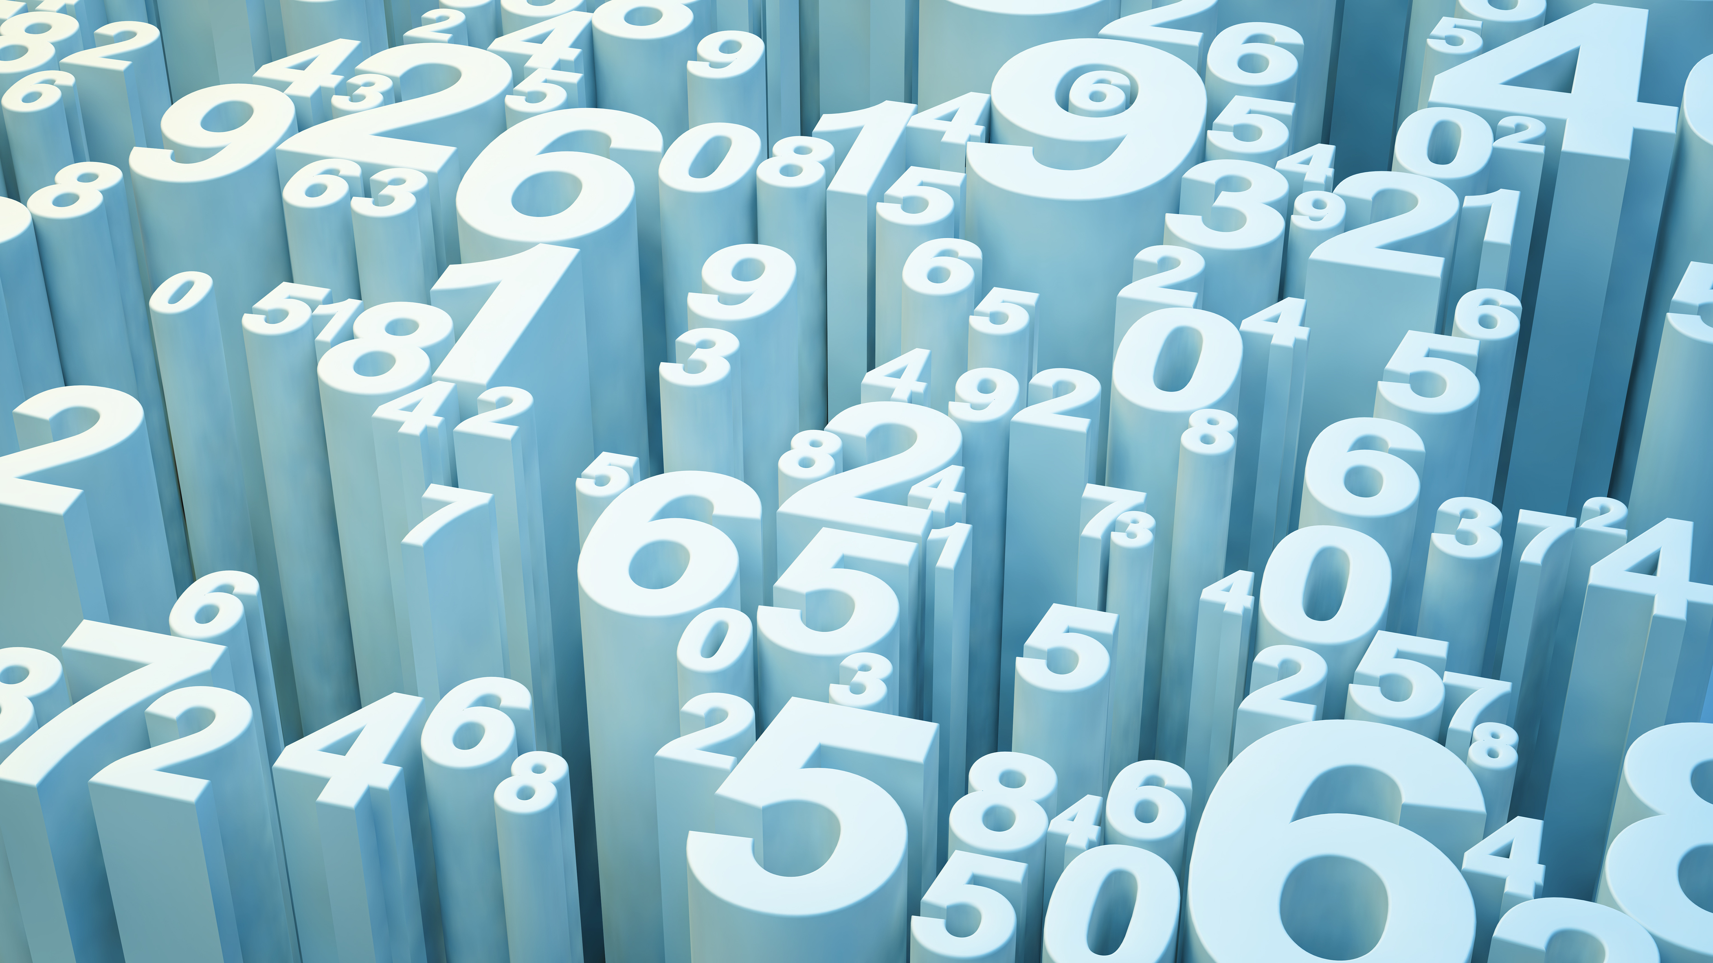
Handwritten Digits Recognition
Project A
Neural Networks and Pandas TensorFlow
F. A. Barillas

Slide 2
Goal: To correctly read handwritten single digits
Design the Model
TensorFlow
Train the Model
Test the Model
60,000 images
Load New Images
10,000 images
4 Layers
Verify Accuracy
Pre-Processing
Write and Scan
Process to match correct input format
Make them available to algorithm

Slide 3
The Neural Network
Input Layer
Dense Layer
Dense Layer
Output Layer
1
2
3
4
5
6
7
8
9
0
784 neurons
(28x28 Flattened)
2⁸ neurons each layer
ReLu Activation
10 neurons
Softmax Activation

Slide 4
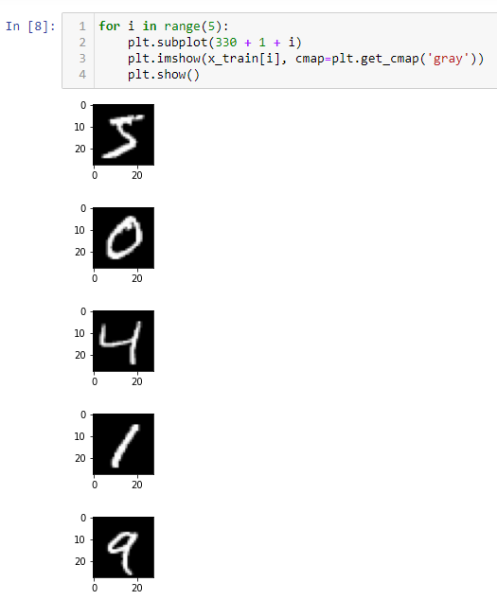
Basic Info
Training data is the keras mnist dataset
70,000 images processed into 28x28 numpy arrays
Each symbol has been mapped using a gray scale on each array cell
Values range from 0 to 255

Slide 5
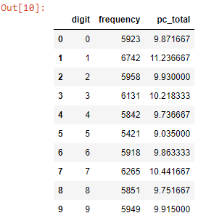
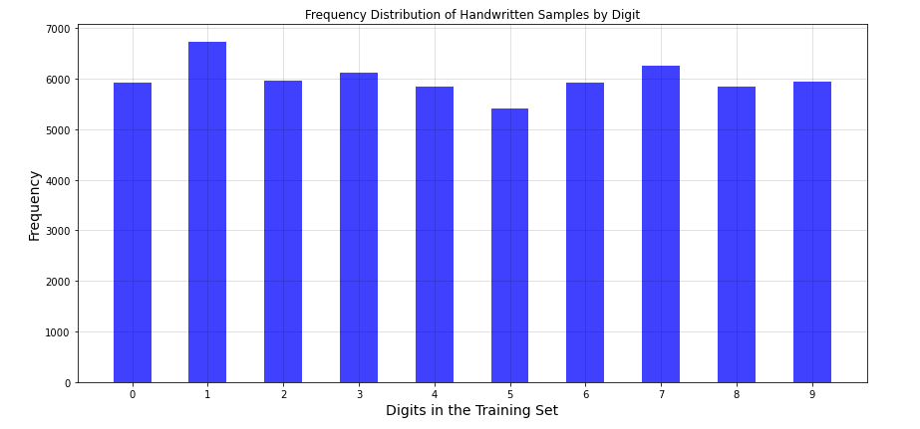
Verifying the training dataset

Slide 6
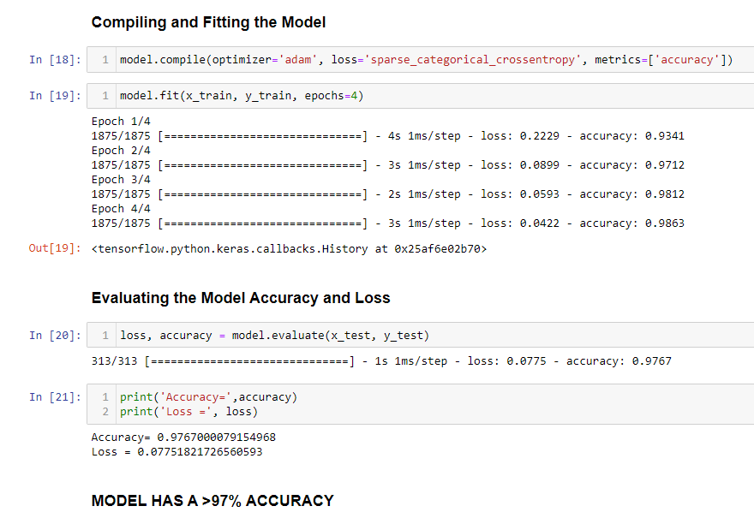
Model Theoretical Performance

Slide 7
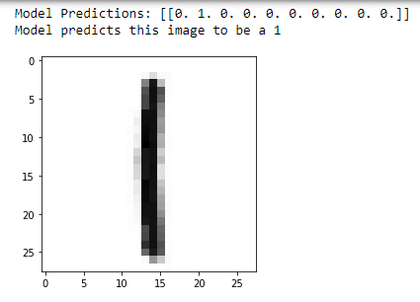
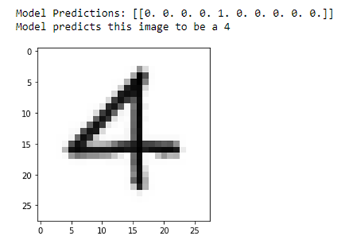
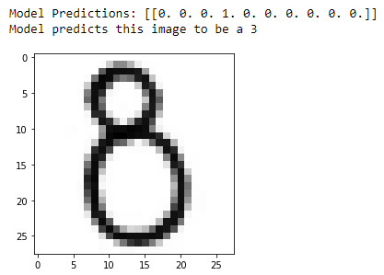
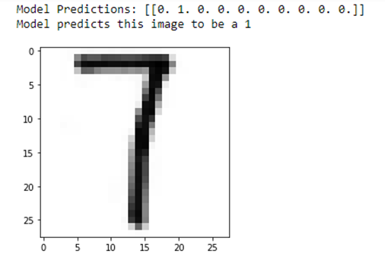
Model Practical Performance
1 -> OK
2 -> OK
3 -> OK
4 -> OK
5 -> OK
6 -> OK
7 -> Not OK (1)
8 -> Not OK (3)
9 -> Not OK (3)
0 -> OK

Slide 8
Computation
Ran Locally
Ran on Google Collaboratory

